Slide 1
Vaccinations by EMS Providers Primarily for AEMTs and Paramedics in the GMVEMSC region

Slide 2
Vaccinations by EMS Providers
Claire Hardman, RN
Candidate for MPH, Wright State University

Slide 3
Vaccinations by EMS Providers
David Gerstner
Regional MMRS Coordinator
Dayton Fire Department

Slide 4
Mission
Provision of a foundation of knowledge based upon the EMS scope of practice and the recommendations from our federal and state public health organizations

Slide 5
Objectives
Understand the transmission, signs, and symptoms of influenza and COVID-19
Gain knowledge of the types of vaccine available and their respective indications, contraindications, and adverse effects
To the degree known at this moment
Understand legal authorization, requirements, limitations, and liability protections regarding administration of immunizations by EMS providers

Slide 6
Objectives
Gain knowledge of the need for partnership between local health departments and EMS agencies during vaccination campaigns and their respective roles and responsibilities
Gain knowledge of the data to be collected and documented prior to, during, and after the administration of a vaccine to a patient
Note the need for vaccination of healthcare workers as a measure of disease prevention

Slide 7
Potential Roles for EMS Personnel During Vaccination Campaigns
Depending on availability of vaccines, potential roles for EMS include:
Vaccinate EMS personnel in your own agency
Vaccinate fire, EMS, and law enforcement personnel in other agencies
Vaccinate other public safety and critical infrastructure personnel (after there is adequate vaccine to provide for the CDC-identified priority groups)
Provide vaccinations in Closed Points of Dispensing (PODs) (closed PODs are vaccination sites limited to specific personnel, such as schools, businesses, etc.)
Assist with vaccinations in Open PODs (sites open to the public)
*Provide Mobile PODs for small sites (e.g., daycare), as well as for homeless and homebound individuals
Individual EMS personnel can also assist LHDs, for example, as MRC volunteers
Note that while vaccines are in short supply, only designated groups can be vaccinated

Slide 8
Influenza
A highly contagious viral illness Virus exists in a three types
Type A: Moderate to severe illness, occurs in all age groups
Type B: Milder illness, occurs primarily in children
Multiple strains in each type of virus

Slide 9
COVID-19
A highly contagious viral illness Caused by SARS-CoV-2 virus

Slide 10
Influenza
Classic symptoms include rapid onset of:
Fever
Myalgia
Sore throat
Nonproductive cough
Headache

Slide 11
COVID-19
Classic symptoms include:
Fever or chills
Cough
Shortness of breath or difficulty breathing
Fatigue
Muscle or body aches
Headache
New loss of taste or smell
Sore throat
Congestion or runny nose
Nausea or vomiting
Diarrhea

Slide 12
Influenza
Respiratory transmission
Incubation period of 2 days (range of 1-4 days)
Infected persons can transmit the virus up to 2 days before onset of symptoms
Adults can be contagious up to 5 days after onset of symptoms
Children can be contagious up to 10 days after onset of symptoms

Slide 13
COVID-19
Respiratory transmission
Incubation period of up to 14 days with highest rates of transmission in first 5 days
Infected persons can transmit virus up to 2 days before onset of symptoms

Slide 14
Historic Influenza Pandemics and Deaths in the USA
1918: Spanish Flu – A/H1N1 Greater than 500,000
1957: Asian Flu – A/H12N2 Approximately 69,800
1968: Hong Kong Flu – H3N2 Approximately 33,800
2009: Swine Flu – Novel strain of A/H1N1 CDC data: 12,469

Slide 15
Recent Impact of Influenza in the USA
CDC Data | 2018-2019 | October 1, 2019 through April 4, 2020 (estimate)
Illnesses | Greater than 35.5 million | 39 million to 56 million
Medical visits | Greater than 16.5 million | 18 million to 26 million
Hospitalizations | 490,600 | 410,00 to 740,000
Deaths | 34,200 | 24,000 to 62,000

Slide 16
Seasonal Influenza
Onset and duration of influenza season is variable
Typically begins in mid-October Peaks between December and March Vaccine administration
Ideally in the fall
However encouraged throughout the entire influenza season

Slide 17
Evolution of the Influenza Vaccine
Influenza vaccines protect against multiple strains of influenza in one dose
Trivalent – A/H1N1, A/H3N2, type B
Quadrivalent – A/H1N1, A/H3N2, two types of B

Slide 18
Types of Influenza Vaccine
Inactivated
Intramuscular
Intradermal
Live attenuated
Intranasal
Approved only for healthy, non-pregnant patients age 2 years through 49 years

Slide 19
Types of COVID-19 Vaccine
Seven now in Phase 3 trials
Approval or Emergency Use Authorization expected soon
for at least two
All COVID vaccines in Phase 3 trials as of November,
2020 are administered IM except Inovio
Inovio uses a proprietary device

Slide 20
Vaccination Administration by EMS Providers
Route of administration is within the EMS scope of practice for the certificate holder
IM administration (except auto-injectors) limited to Advanced EMTs and Paramedics
Administration is pursuant to medical direction and training on the specific vaccine
Adherence to the recommendations and instructions of the FDA

Slide 21
Requirements
Appropriate training for the specified vaccine prior to participating in its administration
Physician medical direction
Certified EMS providers may not exceed the EMS scope of practice authorized by the EMFTS Board regardless of any training and protocols provided by the EMS medical director

Slide 22
Liability Protections
Agent or employee of an EMS agency
Organization or employer that is not an EMS agency
Federal declaration of emergency Medical Reserve Corps (MRC)

Slide 23
Partnership with Public Health
LHDs are critical in the determination of:
Data collection to identify geographic regions of prevalence and severity of disease
Appropriate dosing of vaccines
Acquisition and storage of medical records
Prioritization of available resources to at-risk populations
Determine points of distribution of the vaccine

Slide 24
Vaccine Administration
Guidelines

Slide 25
Vaccine Administration
Appropriate vaccine administration is critical to vaccine effectiveness
Guidelines for vaccine administration
Professional standards for medication administration
Vaccine manufacturers’ recommendations
CDC's Advisory Committee on Immunization Practices (ACIP) General Recommendations on Immunization
State and agency policies and procedures

Slide 26
Vaccine Administration
There are multiple formulations of influenza vaccine
Likely to be multiple formulations of COVID-19 vaccine
LHDs and EMS providers should follow the manufacturer’s recommendations for vaccine dosing and administration
All patients must be screened for contraindications prior to administration of the vaccine
Epinephrine should always be readily available to treat anaphylaxis if it occurs

Slide 27
Inactivated (Intramuscular) Influenza Vaccine Contraindications/Precautions
Contraindications:
Severe allergic reaction or systemic hypersensitivity to a previous influenza vaccine
Known allergy or previous systemic hypersensitivity to egg or chicken protein, neomycin or polymyxin
Precaution:
Persons who are already moderately or severely ill

Slide 28
Immunocompromised persons may have a reduced immune response to the vaccine
Inactivated (Intramuscular) Flu Vaccines Warnings and Precautions
If Guillain-Barré syndrome has occurred within 6 weeks of receipt of a prior influenza vaccine, the decision to give the vaccine should be based on careful consideration of the potential benefits and risks and discussed with the patient’s primary healthcare provider

Slide 29
Patient Counseling
The intramuscular influenza vaccine is an inactivated vaccine that cannot cause influenza and acts by stimulating the immune system to produce antibodies to prevent infection from the virus
Any severe or unusual adverse reactions should be reported to their healthcare provider

Slide 30
Patient Preparation
Atraumatic Care
Positioning & Comforting Restraint Pain Control
Topical Anesthetics
Analgesic Agents
Diversionary Techniques

Slide 31
Infection Control
Handwashing procedures
Gloves
Needlestick injuries Equipment disposal

Slide 32
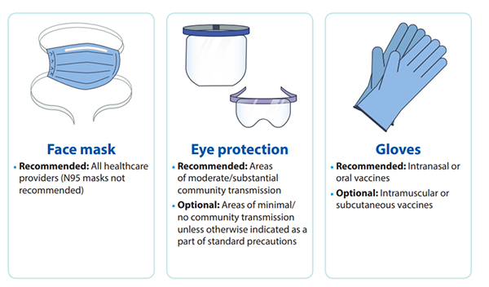
PPE

Slide 33
Vaccine Preparation
Equipment Selection
Syringe Selection: 1 mL to 3 mL
Needle Selection: 22 gauge to 25 gauge

Slide 34
Vaccine Preparation
Equipment Selection
Needle Length
Infants (1-12 months): 1 inch
Toddlers and Children (1-18 years): 1 inch to 1¼ inch
Adults (Greater than 18 years and older)
< 130 pounds: 1 inch
♀ 130-200 pounds or ♂ 130-260 pounds: 1 inch to 1½ inch
♀ > 200 pounds or ♂ > 260 pounds: 1½ inch

Slide 35
Vaccine Preparation
Inspection of the Vaccine
Expiration date
Visual inspection of the vial
Visual inspection of the vaccine

Slide 36
Vaccine Preparation
Shake the solution
Labeling
Storage considerations
May be other requirements with COVID vaccine

Slide 37
Vaccine Preparation: Precautions
Prefilling syringes
High volume vaccine clinics

Slide 38
Vaccine Administration: Intramuscular
Angle
Site of injection
Toddlers (ages 1-2 years) anterolateral thigh or deltoid
Infants: use anterolateral thigh
>age 2, preferred site deltoid

Slide 39
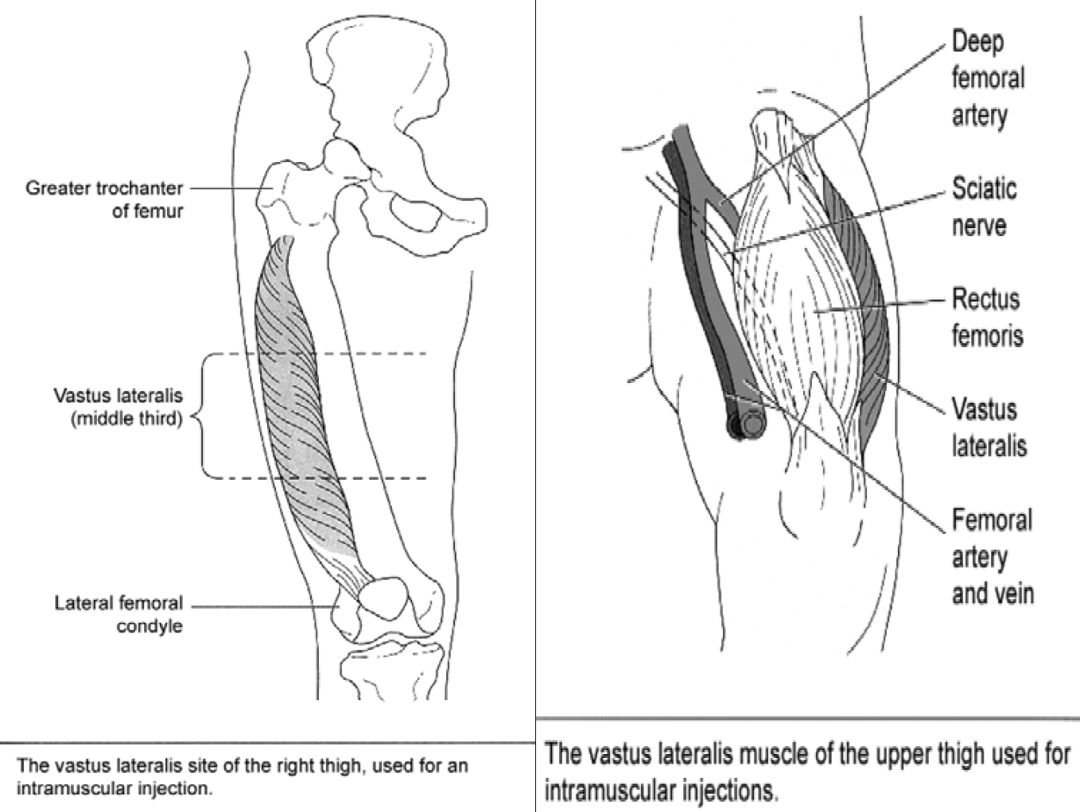

Slide 42
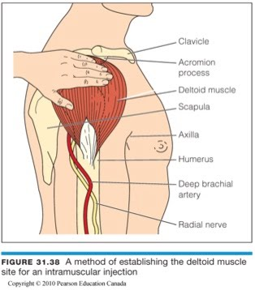
IM Injections in Deltoid Muscle
Use proper landmarks and technique to identify the injection site
Use proper needle length based on age and size of the patient and injection technique
Aspiration is not recommended when administering vaccines

Slide 43
Special Situations
Latex allergy
Bleeding disorders

Slide 44
Intramuscular Influenza Vaccine Adverse Reactions
Fear and/or vasovagal syncope
Local
Systemic Anaphylaxis
Follow the EMS protocols provided by your medical director to address these conditions

Slide 45
Intranasal Influenza Vaccine
Live attenuated intranasal influenza vaccine (LAIV) contains live virus material
Quadrivalent
Indicated for healthy non-pregnant individuals of ages 2 to 49 years
May be preferable in small children because of their fears of injection

Slide 46
Intranasal Influenza Vaccine Contraindications
Children younger than 2 years
Adults 50 years and older
History of severe allergic reaction to any ingredient of the vaccine or to a previous dose of any influenza vaccine
Children 2 years through 17 years old who are receiving aspirin- or salicylate-containing medications

Slide 47
Intranasal Influenza Vaccine Contraindications
Children 2 years through 4 years old with asthma or a history of wheezing in the past 12 months
Immunosuppression from any cause Absent or non-functioning spleen
Caregivers of severely immunocompromised persons who require a protected environment

Slide 48
Intranasal Influenza Vaccine Contraindications
Pregnant women
Cochlear implants
Active leak between the cerebrospinal fluid and the mouth, nose, ear, or other place within the skull
Receipt of flu antiviral drugs within the previous 48 hours for oseltamivir (Tamiflu®) and zanamivir (Relenza®), previous 5 days for peramivir (Rapivab®), and previous 17 days for baloxavir (Xofluza®)

Slide 49
Intranasal Influenza Vaccine Precautions
Asthma in people aged 5 years and older
Other underlying medical conditions associated with higher risk of serious flu complications
Moderate or severe acute illness with or without fever
Guillain-Barré Syndrome within 6 weeks following a previous dose of flu vaccine

Slide 50
Adverse Reactions
Runny nose
Wheezing
Headache
Vomiting
Muscle aches
Fever (low grade)
Sore throat (in older children)
Cough

Slide 51
Intranasal Influenza Vaccine Administration

Slide 52
Documentation
All vaccines administered should be fully documented in the patient’s permanent medical record
Documentation should include:
1. Date of administration
2. Name or common abbreviation of vaccine
3. Vaccine lot number
4. Vaccine manufacturer
5. Administration site, route, and dosage
6. Any vaccine information statements (or equivalent for EUA vaccines) utilized by the public health agency, with edition date
7. Name and address of public health agency’s vaccine administrator who is responsible for the storage of the records
8. Name and title of person who administered the vaccine

Slide 53
Documentation
The patient interview and screening process, including the acquisition of informed consent, to receive the influenza vaccination is determined by the local public health authorities
All patient allergies, including allergies to medications and foods, must be obtained and documented
Influenza vaccine is relatively contraindicated in patients who are allergic to eggs or chicken protein

Slide 54
Documentation
Facilities that administer vaccines are encouraged to participate in state or local immunization information systems
The patient or parent should be provided with an immunization record that includes the vaccines administered with dates of administration

Slide 55
Vaccination Information Statement (VIS)
If your LHD elects to utilize a VIS as part of their documentation process, provide a current VIS to each individual or legal guardian
After the VIS is read by and/or reviewed with the individual or guardian, answer any and all of their questions before vaccine administration
If the LHD provides them, give an immunization record card to the vaccine recipient to provide them with a record of the vaccination administration

Slide 56
Emergency Use Authorization (EUA)
EUA means that a COVID-19 vaccine has been authorized for use. The scope of authorized use is specified in the EUA Fact Sheet for Healthcare Providers (similar to a package insert for licensed vaccines)
For healthcare providers, conditions of use require:
Providing the recipient/caregiver the Fact Sheet for Recipients (similar to a vaccine information statement [VIS] for licensed vaccines), which communicates vaccine benefits and risks to the recipient, via hard copy or electronic means
Reporting vaccine administration data to CDC
Reporting vaccine administration errors and specified adverse events to VAERS

Slide 57
Reporting to the Vaccine Adverse Event Reporting System (VAERS)
Healthcare providers are required to report the following to VAERS:
Vaccine administration errors (whether associated with an adverse event [AE] or not)
Serious AEs (irrespective of attribution to vaccination)
Multisystem inflammatory syndrome (MIS) in children (if vaccine is authorized for use in children) or adults
Cases of COVID-19 that result in hospitalization or death after the recipient has received COVID-19 vaccine
Healthcare providers are also encouraged to report any clinically significant AEs that occur after vaccine administration
Adverse events should be reported even if the cause of the AE is uncertain
Healthcare providers should report any additional AEs and adhere to any revised safety reporting requirements per the FDA conditions of authorized vaccine use posted on FDA’s website throughout the duration of the EUA

Slide 58
EUA Fact Sheet for Healthcare Providers
Each vaccine used under an EUA will come with a specific EUA Fact Sheet for Healthcare Providers will provide the following information:
COVID-19 disease description
Dosage and administration information
Storage and handling instructions
Dose preparation and administration information
Requirements for use of vaccine under EUA
Risks and benefits, including common adverse events (AEs)
Any approved available alternatives for preventing COVID-19
Reporting requirements, including reporting AEs to VAERS
Additional resources

Slide 59
EUA Fact Sheet for Recipients
Each vaccine-specific EUA Fact Sheet for Recipients will provide the following information:
Basic information on COVID-19, symptoms, and what to discuss with a healthcare provider before vaccination
Who should and should not receive the vaccine
That recipients have the choice to receive the vaccine
Dosage and vaccine series information
Risks and benefits of the vaccine, including common side effects
Information on reporting side effects to VAERS
An explanation of what an EUA is and why it is issued
Any approved available alternatives for preventing COVID-19
Additional resources

Slide 60
Skills Checklist for Immunization
Completion of a skills checklist for immunization is suggested
If used, successful completion of the skills checklist for immunization may be verified by an EMS agency’s medical director, LHD, or other designated
A sample skills checklist for immunization administration is available at: https://www.immunize.org/catg.d/p7010.pdf

Slide 61
Reference and Suggested Handout
Epidemiology and Prevention of Vaccine- Preventable Diseases
The Pink Book: Course Textbook
Chapter 12, 13th Edition (2015)
https://www.cdc.gov/vaccines/pubs/pinkboo k/flu.html

Slide 62
COVID-19 Vaccination Efforts
Vaccine Candidates (Vaccines in Phase 3 Trials)
Moderna and National Institute of Health (NIH)
Pfizer and BioNTech
Janssen Pharmaceuticals and Johnson & Johnson (J&J)
Inovio
Novovax
Arcturus
Oncosec

Slide 63
Promising Vaccine Candidates (As of 11/20/2020, limited information is available on vaccines in Phase 2 and 3 Testing, additional information to be announced)
Vaccine Producer | Vaccine Type | Reported Effectiveness | 2nd Dose and Days Between Doses | Cold Chain Requirements | Method of Administration
Moderna and NIH | mRNA | 94.5% | Yes, 28 days | 25° Fahrenheit -4° Celsius | Intramuscular Injection
Pfizer and BioNTech | 3 LNP-mRNA | 90% | Yes, 28 days | -94° Fahrenheit -70° Celsius | Intramuscular Injection
Janssen and J&J | Recombinant adenovirus vector | N/A | Single Dose and 2 Dose Trails taking place | N/A | Intramuscular Injection
Inovio | DNA Plasmid | N/A | N/A | N/A | Cellectra Smart Device
Novavax | Protein subunit adjuvanate | N/A | N/A | N/A | Intramuscular Injection
Arcturus | mRNA | N/A | N/A | N/A | Intramuscular Injection
Oncosec | DNA Plasmid | N/A | N/A | N/A | Intramuscular Injection

Slide 64
Storage and Handling
Proper vaccine storage and handling practices play a very important role in protecting individuals and communities from vaccine-preventable diseases
Failure to store and handle vaccines properly can reduce vaccine potency, resulting in inadequate immune responses in patients and poor protection against disease
For specific, detailed storage and handling protocols for individual vaccine products, always refer to the manufacturers’ product information or contact the manufacturer directly

Slide 65
COVID-19 Vaccine Temperature Excursion
A temperature excursion is any temperature reading that is outside the recommended range for vaccine storage as defined by the manufacturer's package insert or EUA Fact Sheet for Healthcare Providers
Identify temperature excursions quickly and take immediate action to correct them
For COVID-19 vaccines, contact the vaccine manufacturer or your immunization program if you experience temperature excursions

Slide 66
Cold Chain Requirements
All influenza and COVID vaccines have “cold-chain” requirements
Specified temperatures at which vaccine must be kept during transport, storage, administration, etc.
Cold-chain requirements often differ, e.g., storage vs. just prior to administration
Cold-chain requirements are specific to each vaccine
e.g., with Pfizer and BioNTech vaccine, dry ice needed for transportation and storage when not at -94° Fahrenheit (-70° Celsius) in a freezer.

Slide 67
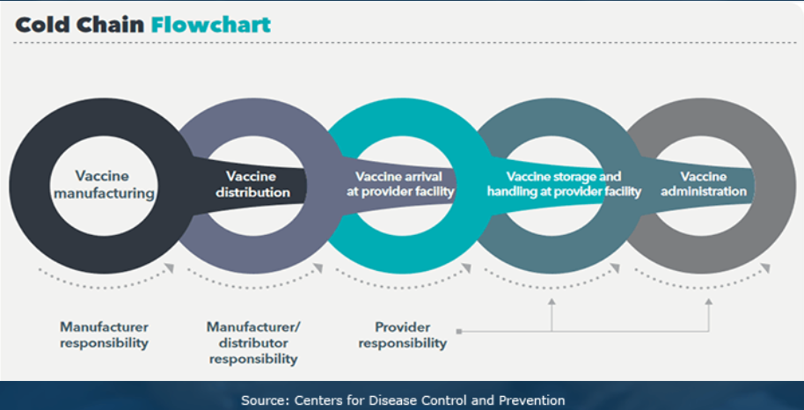
Cold Chain Requirements
Each vaccine will have cold chain requirements
Specific to each vaccine, with different requirements at different points (shipping and storage vs. pre-administration as examples)
Critical to maintain cold chain appropriate to that vaccine

Slide 68
Thawing Processes for COVID Vaccines
Specific to each vaccine
Information will be distributed as it becomes available

Slide 69
Diluent Reconstitution
Some COVID vaccines will require use of a diluent or reconstitution
Specific information will be shared as soon as it is officially available
Reconstitute vaccines according to the manufacturer’s package insert
Use ONLY the diluent supplied by the manufacturer for that specific vaccine

Slide 70
Last Steps
Watch the two other short videos (links are on the training page)
What’s in a COVID Vaccine Box at https://www.msn.com/en-us/video/peopleandplaces/what-s-inside-an-operation-warp-speed-vaccine-distribution-box/vi-BB1bdqqt?ocid=spartan-ntp-feeds
IM Injection Sites at https://www.youtube.com/watch?v=PqSuCPnPeYE
Successfully complete the quiz to receive your Continuing Education Certificate

Slide 71
Our thanks to:
Ohio Department of Public Safety, Division of EMS
Carol Cunningham, MD, Ohio EMS Medical Director
Greater Miami Valley EMS Council for providing Continuing Education Credit for this presentation
The Local Health Departments in our region

